Slide 1
HUMAN STRESS MANAGEMENT
COURSE: FUNDAMENTALS OF DATA SCIENCE SEMESTER: FALL 2022 NAMES: VIJAYA BOPPANA (ID:338674) NOOKA NIKHILA DUBASI (ID:335487) NIKHIL VALETI (ID:337418)

Slide 2
Contents
Introduction
Setup and Import
Data Description
Data Visualization
Algorithms
Conclusion

Slide 3
Data Science : What does it mean?
Data science is an interdisciplinary field that uses scientific methods, processes, algorithms and systems to extract knowledge and insights from noisy, structured and unstructured data, and apply knowledge and actionable insights from data across a broad range of application domains.
Data science is related to data mining, machine learning and big data.

Slide 4
Applications of Data Science
The role of Data Science Applications hasn’t evolved overnight.
Thanks to faster computing and cheaper storage, we can now predict outcomes in minutes, which could take several human hours to process. The following are several applications ,
Fraud and Risk Detection, Healthcare, Internet Search , Targeted Advertising,
WebsiteRecommendations,ImageRecognition,Speech Recognition, Airline Route Planning, Gaming etc.,

Slide 5
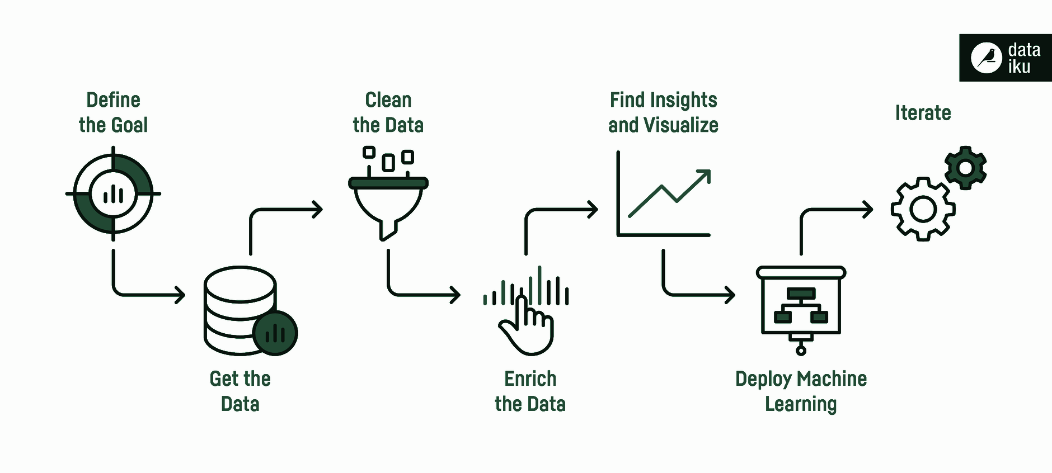
Life Cycle Of a Data Science Project :

Slide 6
Intro to Our Project: Human Stress Detection
Human stress analysis has received special attention in the recent decades due to its impact on human life performance.
Detection,characterization and treatment of human stress are ongoing re-search areas that are still attracting a lot of attention due to their
importance in our daily lives.
Some of the stress sources are due to ﬁnancial, economical, political, chemical, biological, physical as well as social factors.
Several stress sources lead to various human disorders, diseases, depression.

Slide 7
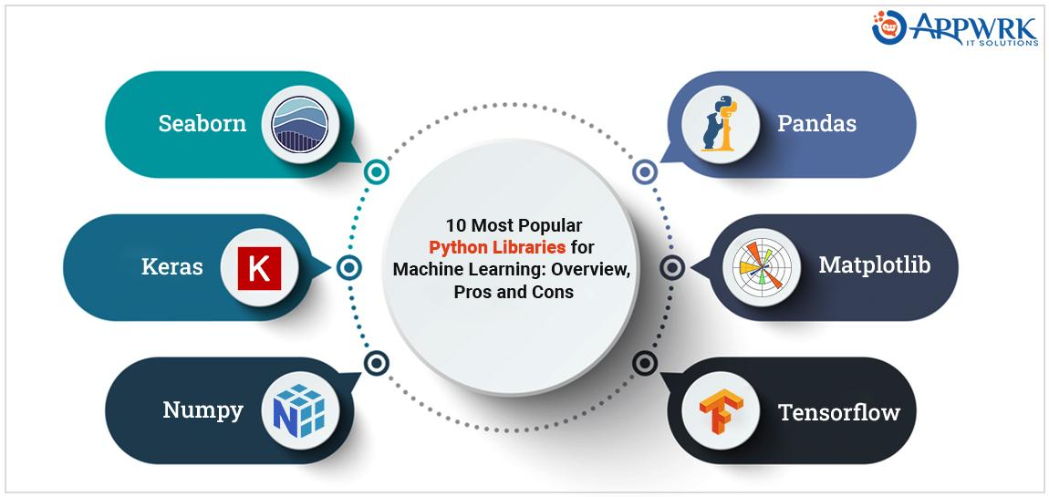

Slide 8
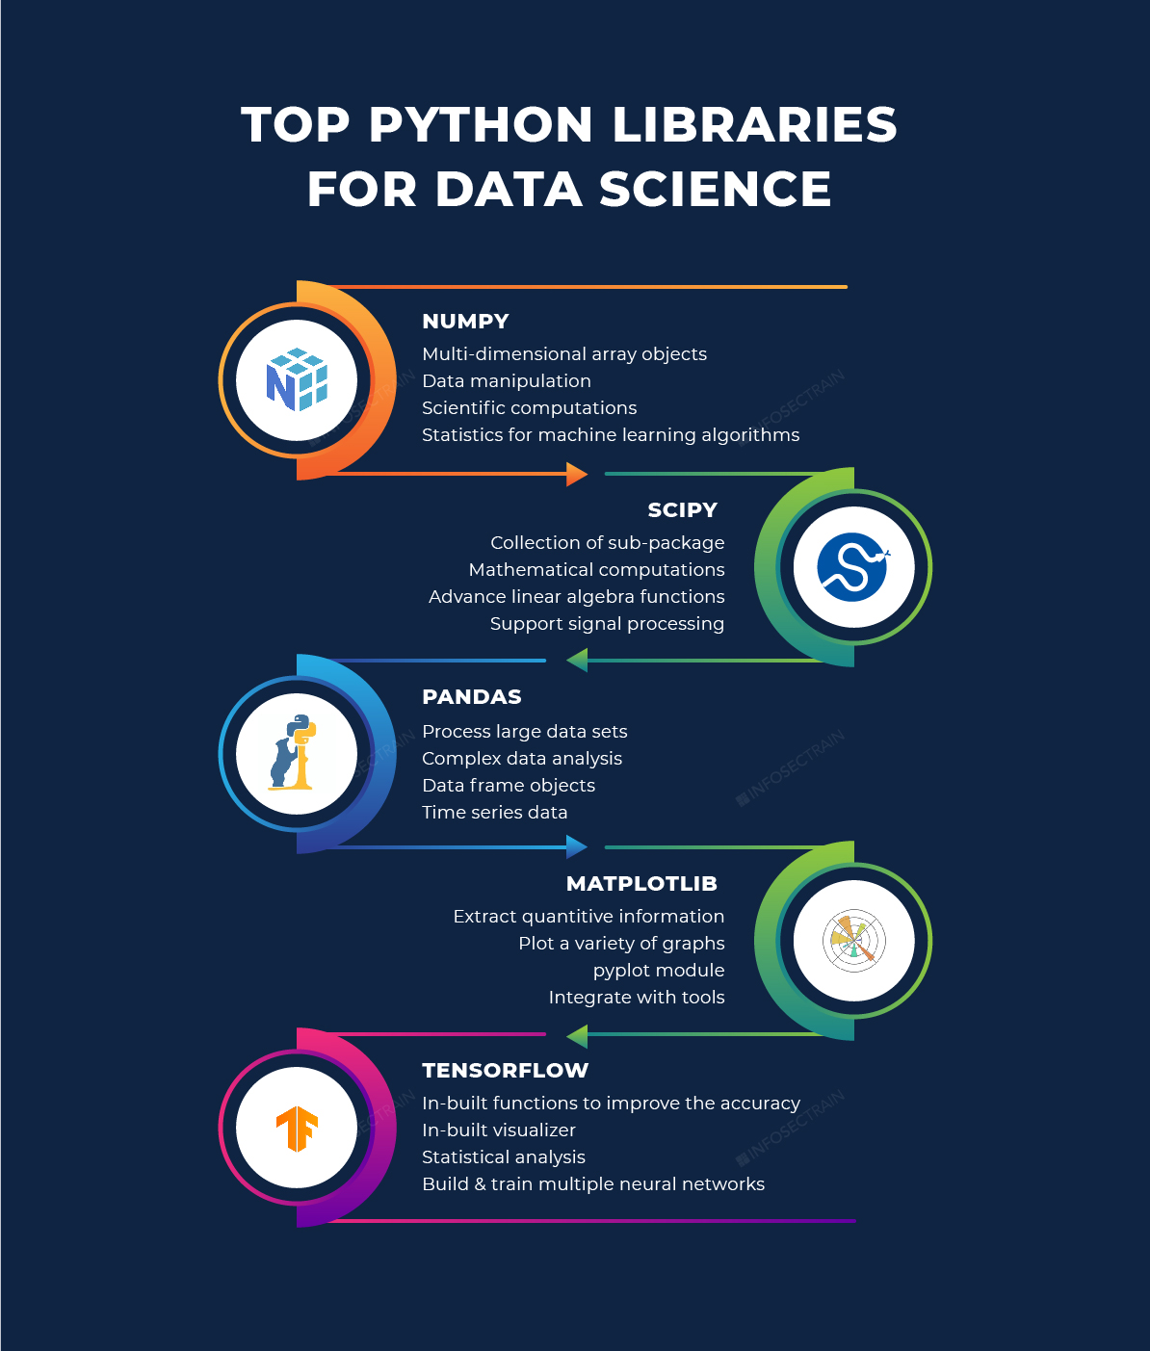
Tools & Technologies used for this Project :
Languages:
Python Programming.
IDEs:
Jupyter Notebook.
Data Science Libraries That I Used:
Pandas (Analysis)
Numpy (Analysis)
Matplotlib (Visualization)
Plotly (Visualization)
Scikit Learn (Machine Learning)
Seaborn (Visualization) etc.,

Slide 9
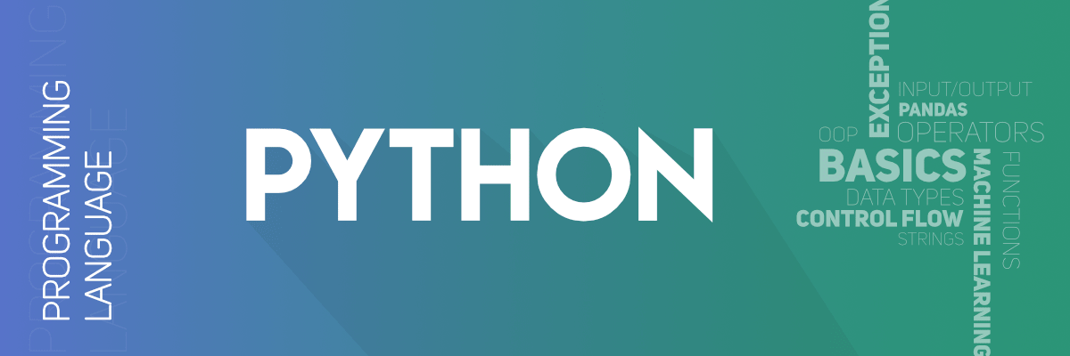
Python Advantages:
The syntax of Python is straightforward and resembles that of English.
Python's syntax differs from various other programming languages in that it enables programmers to construct applications with fewer lines of code.
Python operates on an interpreter system, allowing for the immediate execution of written code. As a result, prototyping can proceed quickly.

Slide 10

A Jupyter Notebook document is a JSON file, following a versioned schema, usually ending with the ".ipynb" extension. The main parts of the Jupyter Notebooks are: Metadata, Notebook format and list of cells. Metadata is a data Dictionary of definitions to set up and display the notebook. Notebook Format is a version number of the software. List of cells are different types of Cells for Markdown (display), Code (to execute), and output of the code type cells.
While ".ipynb" and JSON are the most common and default format it is possible to forgo some features (like storing images and metadata), and save notebook as markdown documents using extension like JupyText.Jupytext is often in conjunction with version control to make diffing and merging of notebook simpler.

Slide 11
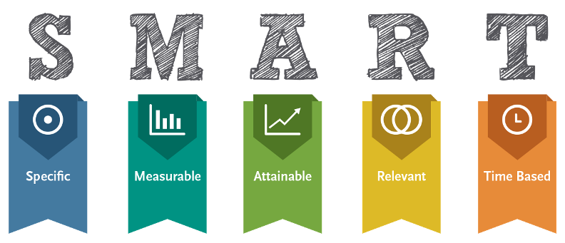
Goals Of this Project :
I want Demonstrate the potential of Data Science and Machine Learning for developing robust, continuous, and noninvasive methods for stress detection by analyzing the sample dataset with the end goal of improving the quality of life.
The conclusion of this project is that the machine learning algorithms that have been used, can identify the stress levels, which is usable for further developments in the fields of Health Care.

Slide 12
Steps involved in this Project :
1.Data Gathering
I Got the dataset of this project from Kaggle.com.
2.Data Analysis
Data analysis is a process of inspecting, cleaning, transforming, and modelling data with the goal of discovering useful information, informing conclusions, and supporting decision-making.
3.Data Preprocessing
Data preprocessing is the process of transforming raw data into an understandable format. It is also an important step in data mining as we cannot work with raw data.

Slide 13
Steps involved in this Project :
4.Data Visualization
Data Visualization techniques involve the generation of graphical or pictorial representation of DATA, form which leads you to understand the insight of a given data set.
5.Modeling
Training & testing phases of Machine learning algorithms involved in this step.
6.Communications
I Feel Communicating results is also one of the important step to maximize the usage of the model.

Slide 14
Importing the Required Modules for this project:
import numpy as np
import pandas as pd
import seaborn as sns
import matplotlib.pyplot as plt
%matplotlib inline
import seaborn as sns
from sklearn.tree import DecisionTreeClassifier
from sklearn.metrics import confusion_matrix
from sklearn.metrics import classification_report
from sklearn.svm import SVC
from sklearn.ensemble import GradientBoostingClassifier
from sklearn.neighbors import KNeighborsClassifier
from sklearn.linear_model import SGDClassifier

Slide 15
SetUp and Imports
The different modules must be imported to visualize the data such as pandas,numpy,matplotlib,seaborn. ● The dataset is taken from the kaggle and implemented the different visualizations and machine learning algorithms to find out accuracy/score about covid 19 result.

Slide 16
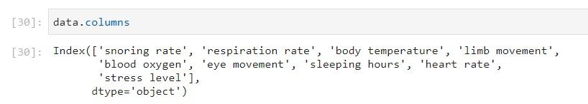
Data Description
Data.columns is used to represent the columns of the data set.

Slide 17
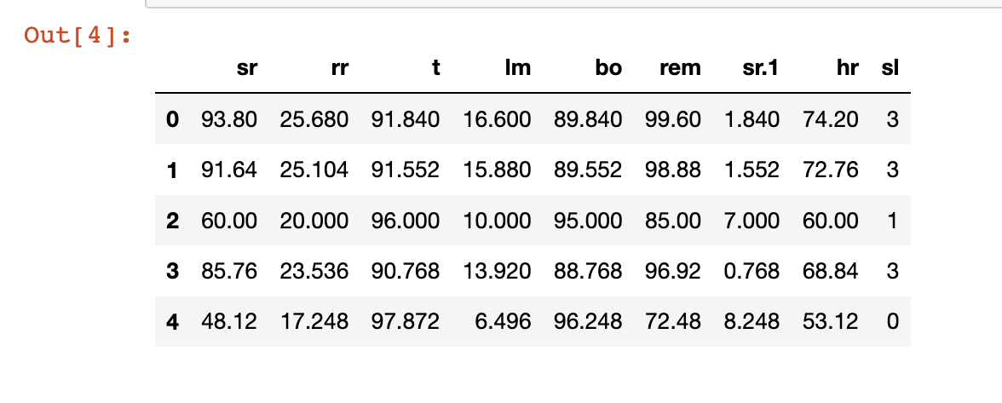
Reading the Dataset :
data = pd.read_csv('Stress_Detection.csv') #Reading the Dataset using Pandas
data.head(5) #printing the first 5 Rows of the Dataset.

Slide 18
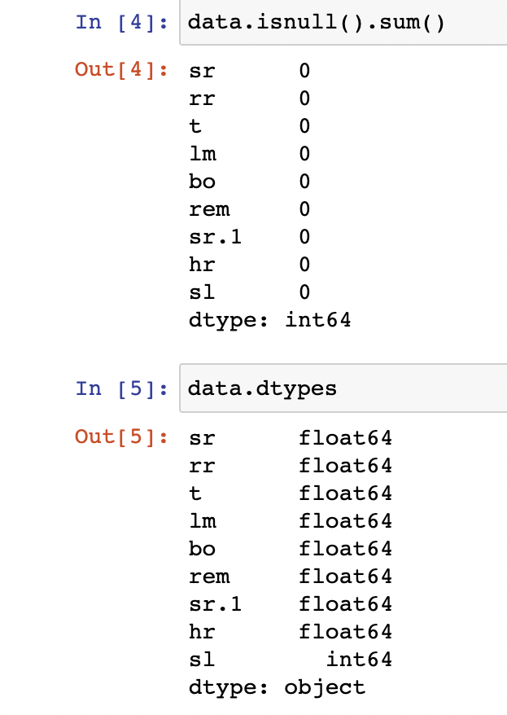
Finding Null Values and type of data :
data.isnull().sum() :
The function dataframe. isnull(). sum().
sum() returns the number of missing values
in the data set.
data.dtypes :
This function returns the data type of each
and every Column in the dataset.

Slide 19
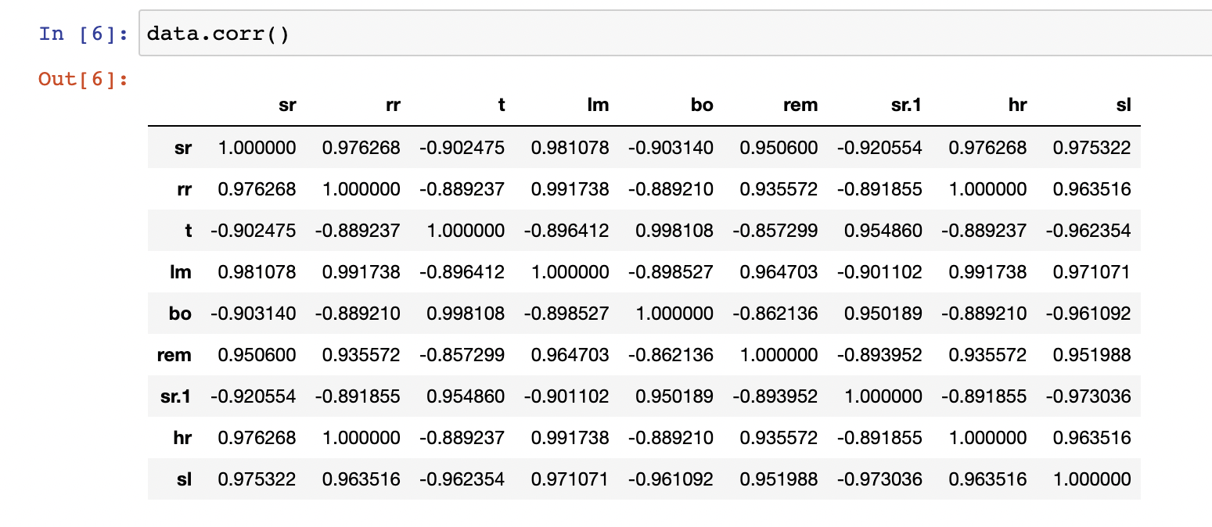
dataframe.corr() :
Pandas dataframe.corr() is used to find the pairwise correlation of all columns in the dataframe. Any na values are automatically excluded. For any non-numeric data type columns in the dataframe it is ignored.
Eg: Data.corr()

Slide 20
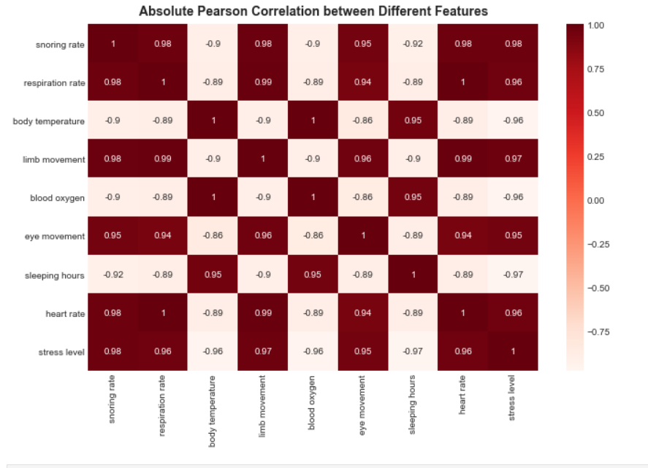
Absolute Pearson Correlation between Different Features Using Heat Map :

Slide 21
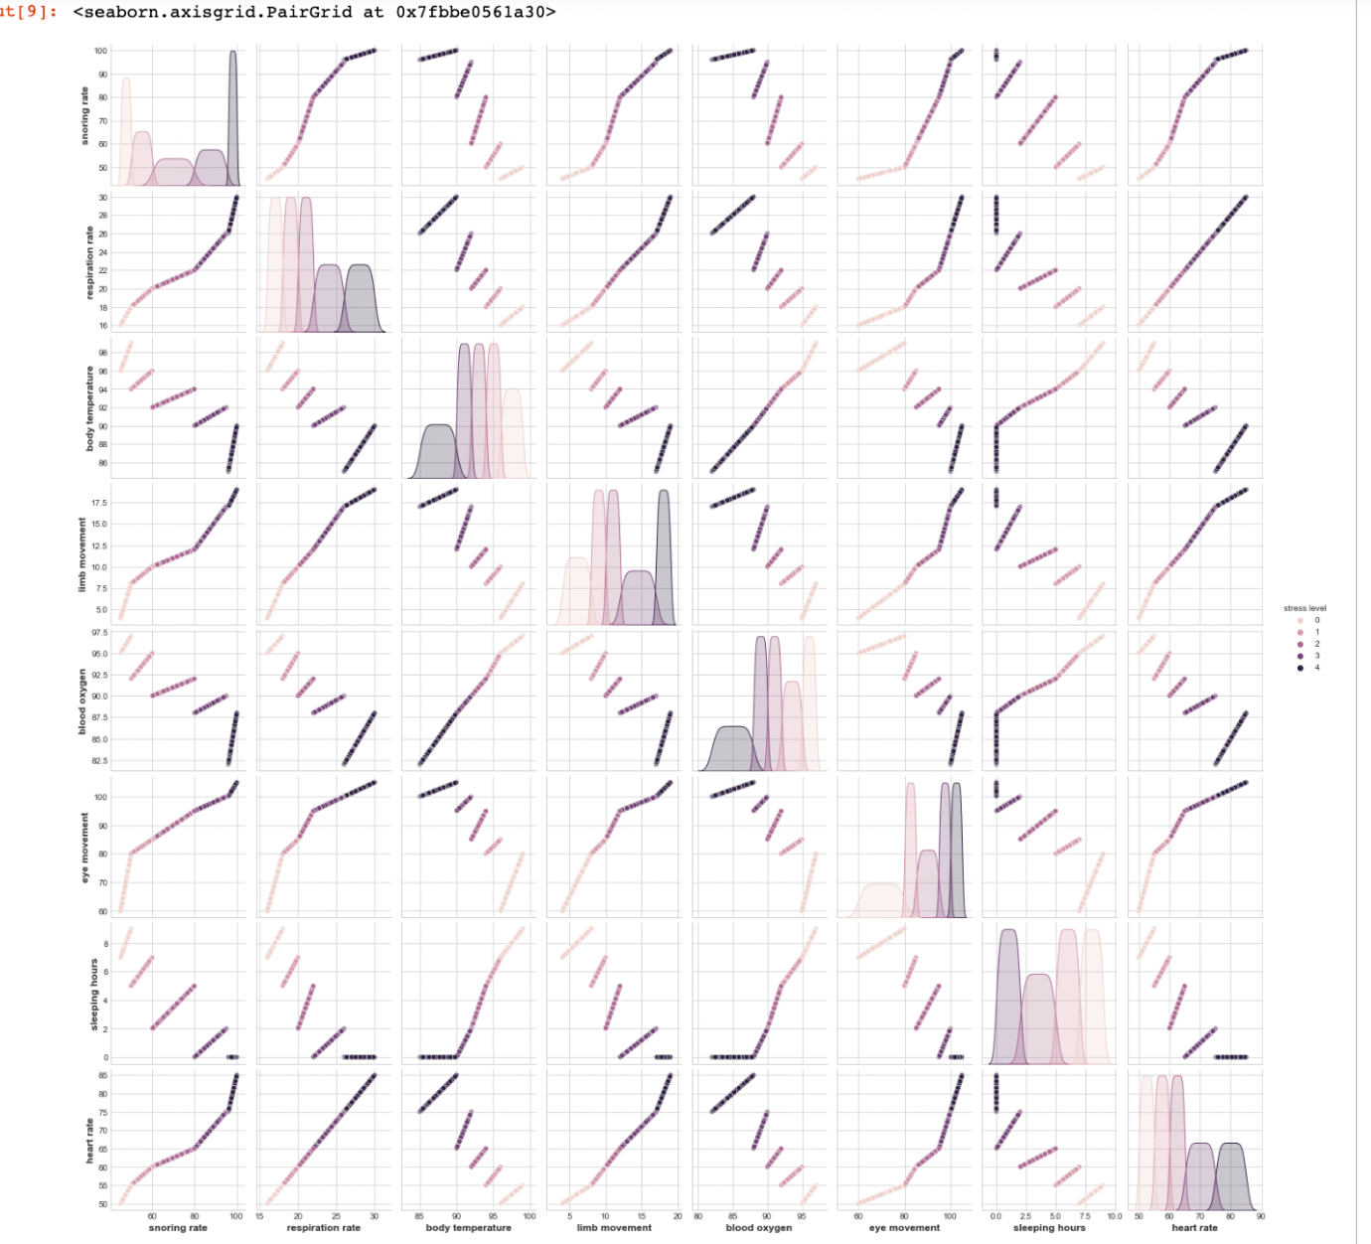
Plotting the data using Pairplot form Seaborn :
A pairplot plot a pairwise relationships in a dataset. The pairplot function creates a grid of Axes such that each variable in data will by shared in the y-axis across a single row and in the x-axis across a single column.
Eg :sns.pairplot(data, hue='stress level')

Slide 22
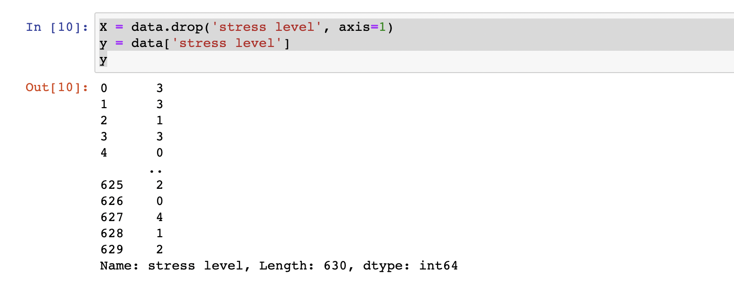
Selecting target Variable and splitting data for Train & Test :
X = data.drop('stress level', axis=1) #Stress Level is our target Variable
y = data['stress level']
Y
from sklearn.model_selection import train test_split
X_train, X_test, y_train, y_test = train_test_split(X, y, test_size = 0.20, random_state = 0) #Using train_test_split method

Slide 23
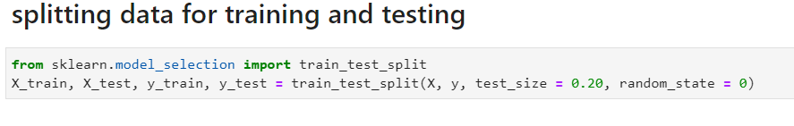
Splitting data for training and testing:

Slide 24
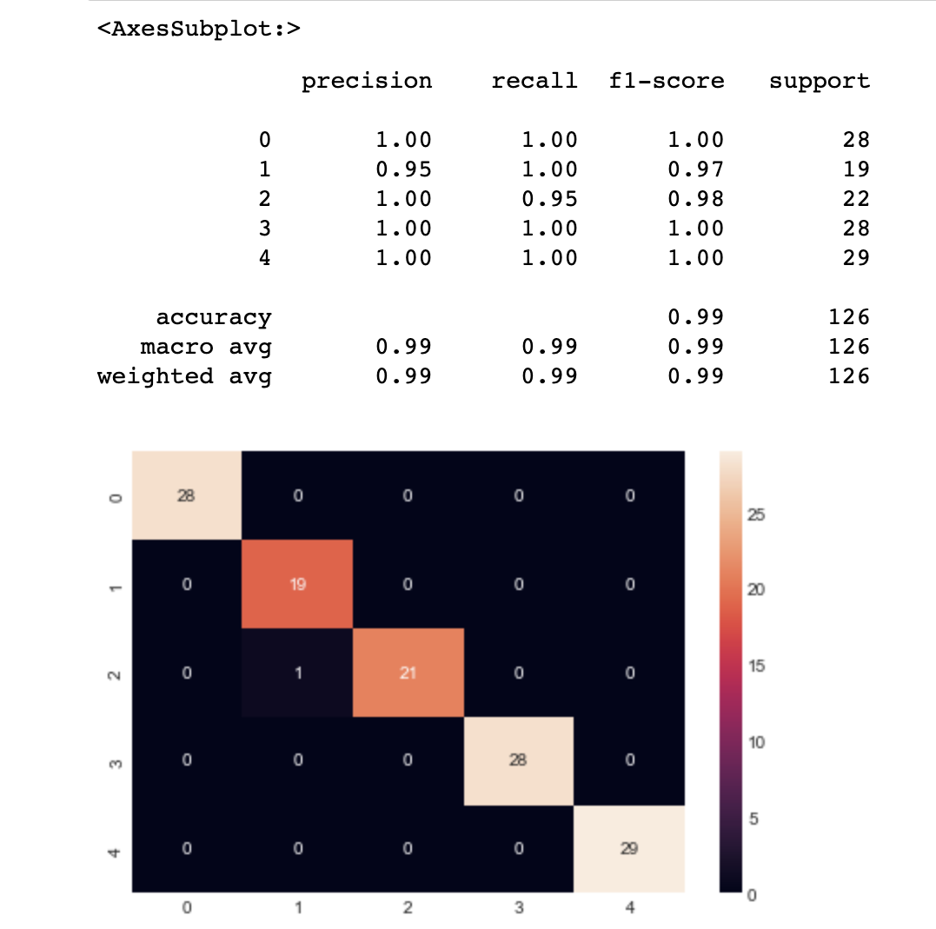
Decision Tree Algorithm :
from sklearn.tree import DecisionTreeClassifier
from sklearn.metrics import confusion_matrix
from sklearn.metrics import classification_report
dtree = DecisionTreeClassifier(random_state=1503,max_depth=4)
dtree.fit(X_train, y_train)
pred = dtree.predict(X_test)
display(sns.heatmap(confusion_matrix(y_test,pred),annot=
True))
print(classification_report(y_test,pred))

Slide 25
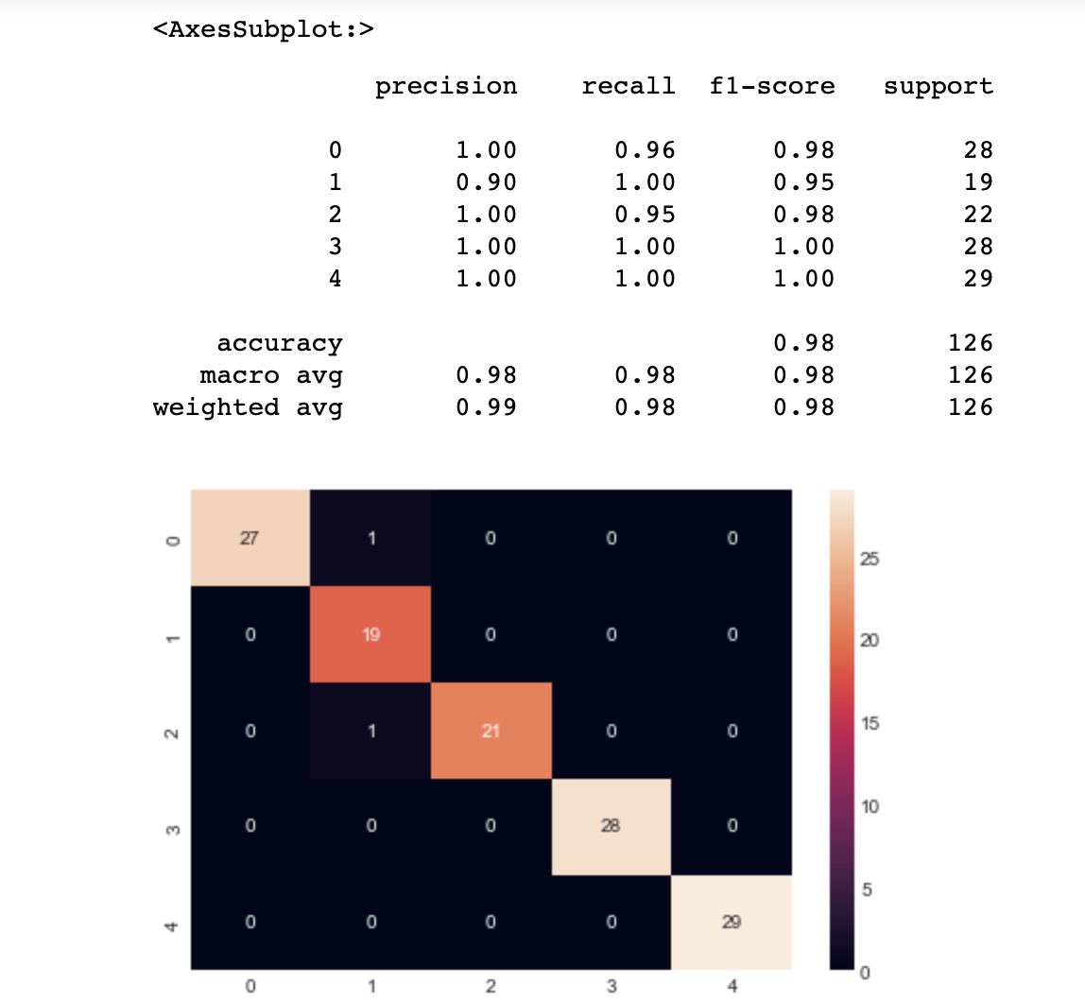
SVM Algorithm :
from sklearn.svm import SVC
svc = SVC(kernel='rbf')
svc.fit(X_train, y_train)
pred = svc.predict(X_test)
display(sns.heatmap(confusion_matrix(y_test,pred),annot=
True))
print(classification_report(y_test,pred))

Slide 26
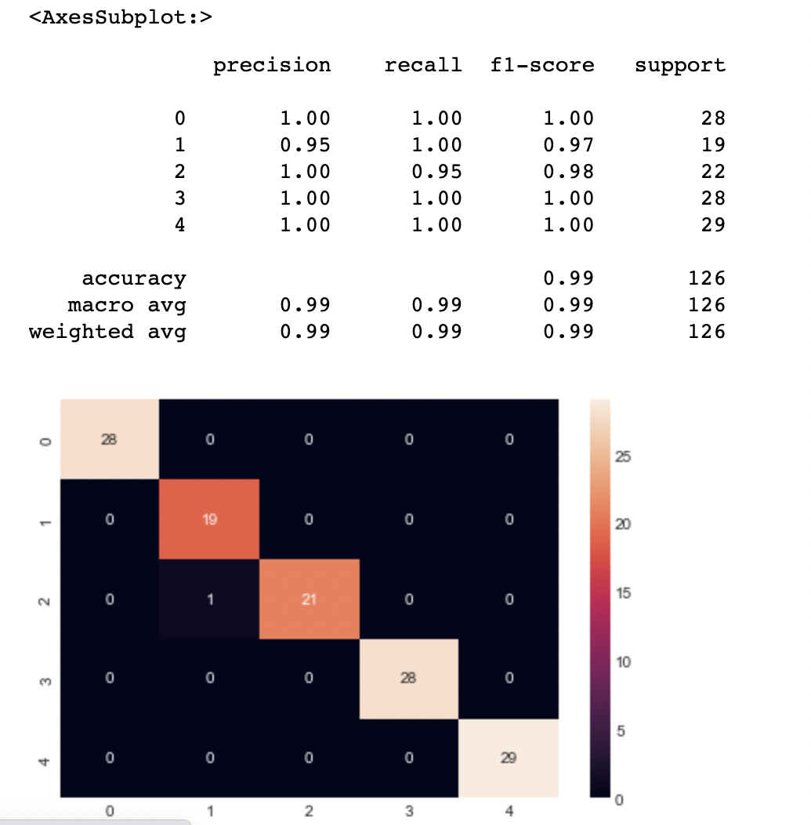
Gredient Boosting classifier Algorithm :
from sklearn.ensemble import GradientBoostingClassifier
gbc = GradientBoostingClassifier()
gbc.fit(X_train, y_train)
pred = gbc.predict(X_test)
display(sns.heatmap(confusion_matrix(y_test,pred),annot=
True))
print(classification_report(y_test,pred))

Slide 27
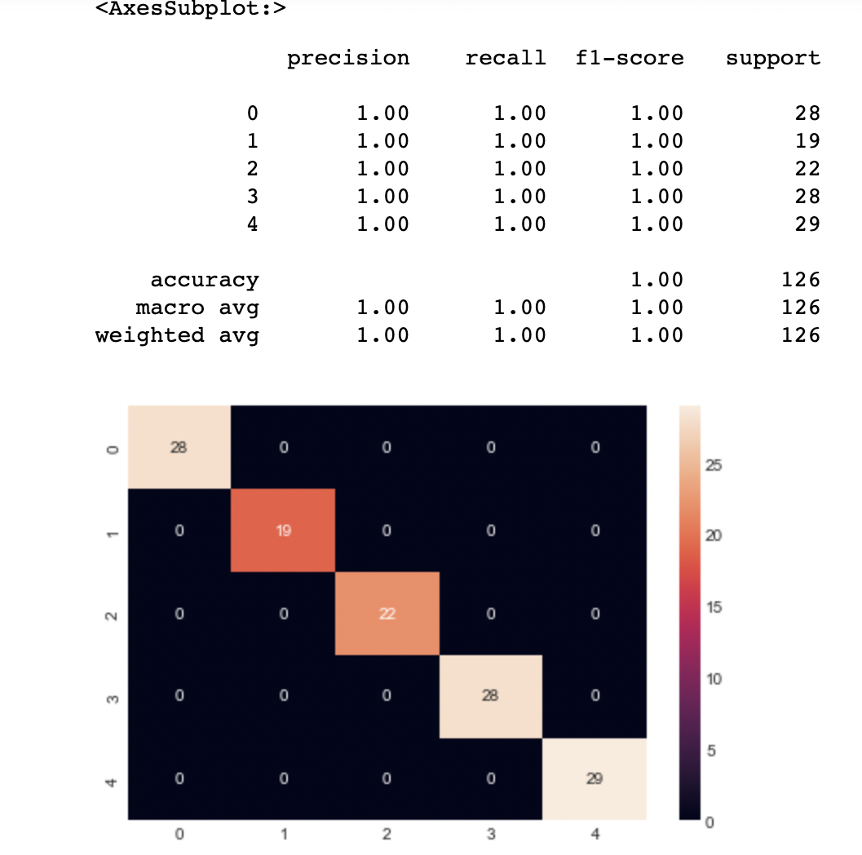
KNN Algorithm :
from sklearn.neighbors import KNeighborsClassifier
from sklearn.neighbors import KNeighborsClassifierknn =
KNeighborsClassifier(n_neighbors=20)
knn.fit(X_train, y_train)
pred = knn.predict(X_test)
display(sns.heatmap(confusion_matrix(y_test,pred),annot=
True))
print(classification_report(y_test,pred))

Slide 28
Accuracy of Each Algorithm:
from sklearn.metrics import accuracy_score
X_train, X_val, y_train, y_val = train_test_split(X, y, test_size = 0.20, random_state = 0)
models = [dtree,svc, knn, gbc]
acc_scores = []
for model in models:
model.fit(X_train, y_train)
y_pred = model.predict(X_val)
acc_model = round(accuracy_score(y_pred, y_val) * 100, 2)
acc_scores.append(acc_model)
acc_scores
Model Name Accuracy score
Decision Tree 99.21
SVC 99.81
k-NearestNeighbors 100
Gradient Boosting Classifier 99.21

Slide 29
Making Predictions by using KNN Algorithm:
snoring_rate = 71.56
respiration_rate = 45.32
body_temperature = 98.7
limb_movement = 5.23
blood_oxygen = 95.45
eye_movement = 78.56
sleeping_hours = 6.2
heart_rate = 60 #Giving Inputs
dd = [[snoring_rate,respiration_rate,body_temperature,limb_movement,blood_oxygen,eye_movement,
sleeping_hours,heart_rate]]
result = knn.predict(dd)
Output :
the stress level is 2

Slide 30
Thank You

